Slide 1
Tipping points
Silvia Caldararu
Email: caldaras@tcd.ie

Slide 2

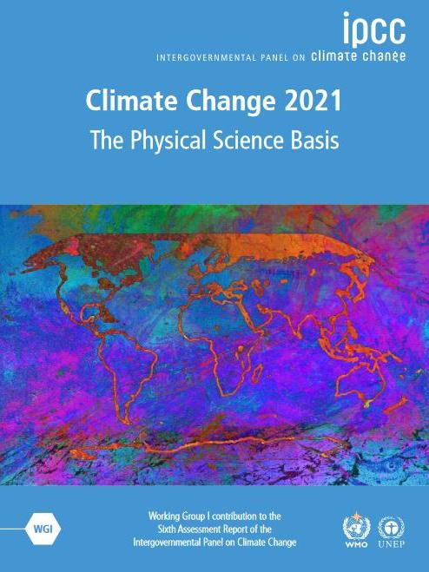
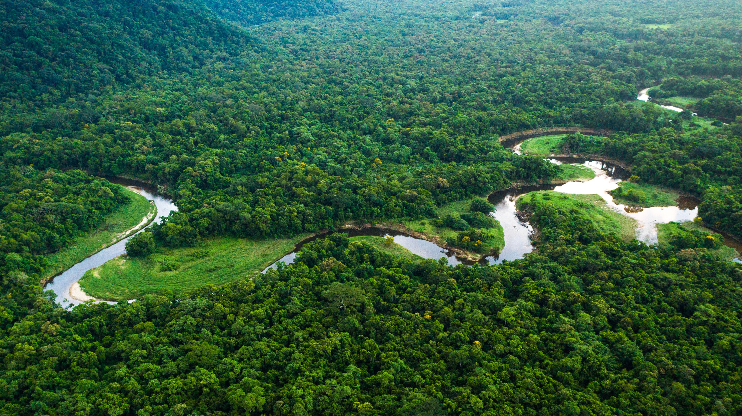

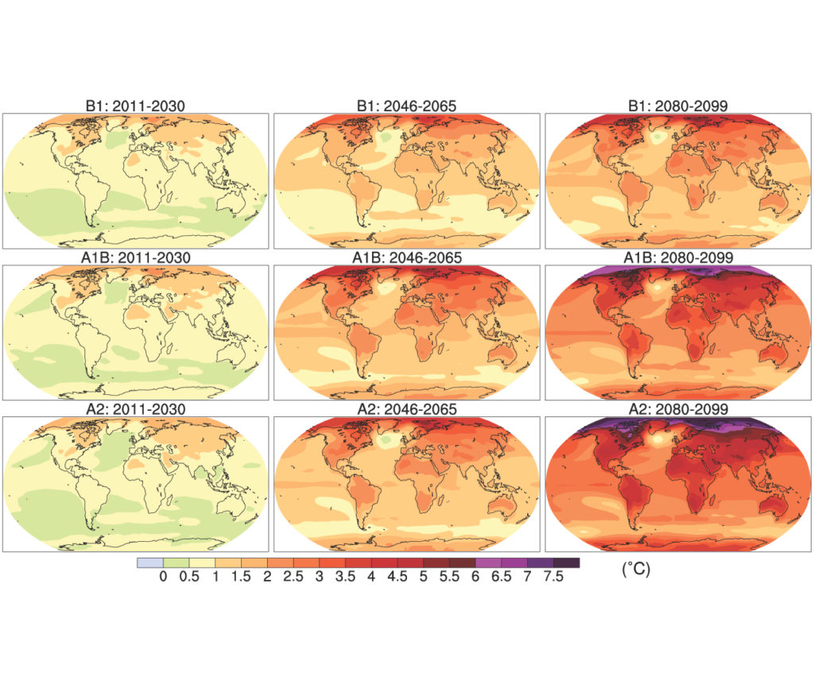
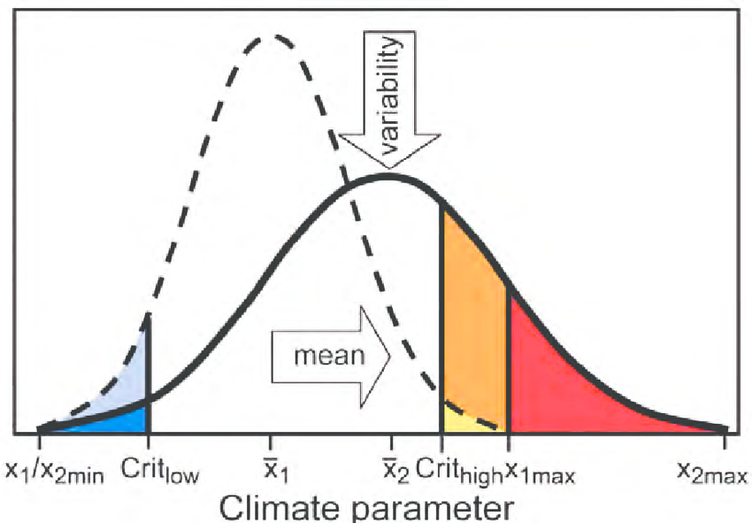
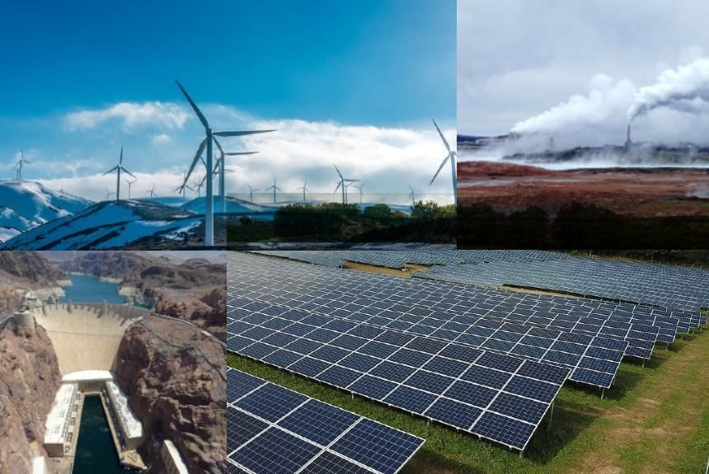
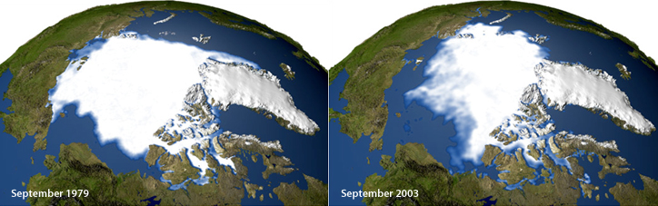
Atmosphere
Climate fundamentals
Predicting climate
Atmosphere
Global C cycle
IPCC report
Earth system models
Climate impacts
Climate solutions
Extreme events
Tipping points
Sea ice, ice caps
Energy
Mitigation
Nature-based solutions

Slide 3
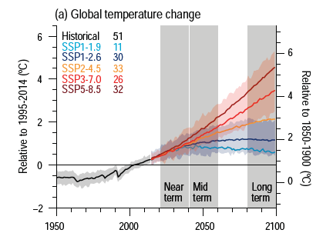
Projections show a monotonous change in climate

Slide 4
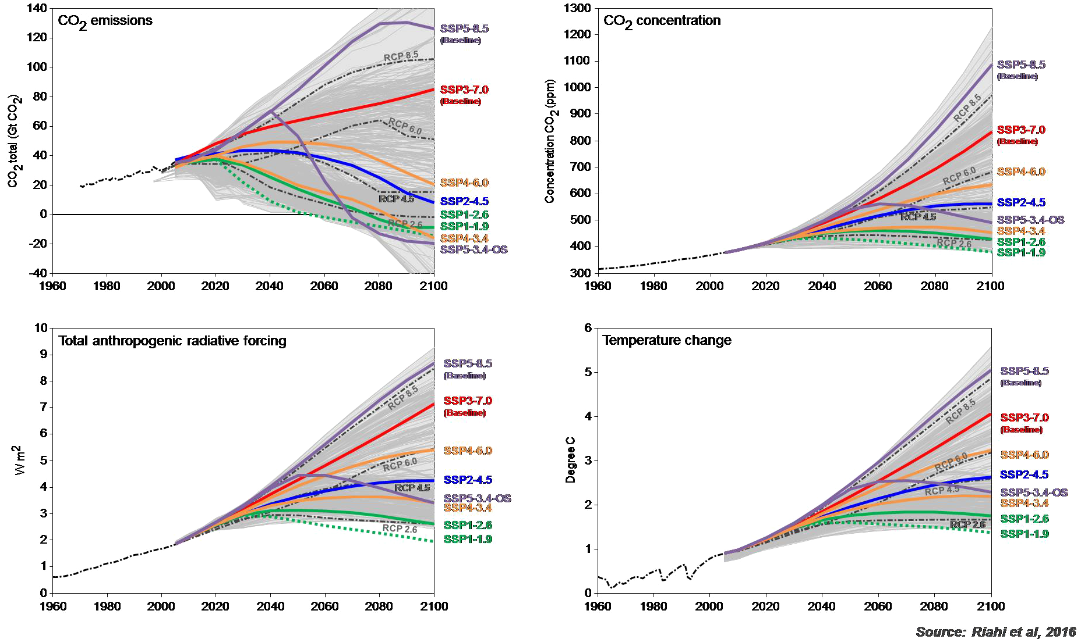
Scenarios assume change is reversible

Slide 5
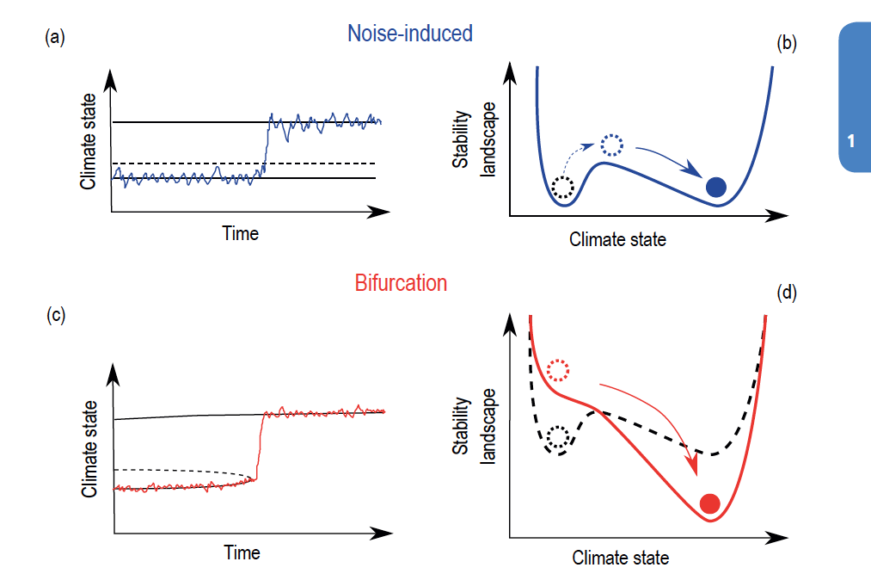
Potential for sudden or irreversible change

Slide 6
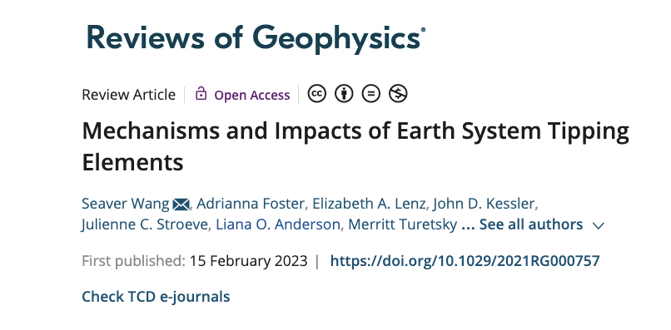
https://agupubs.onlinelibrary.wiley.com/doi/10.1029/2021RG000757

Slide 7
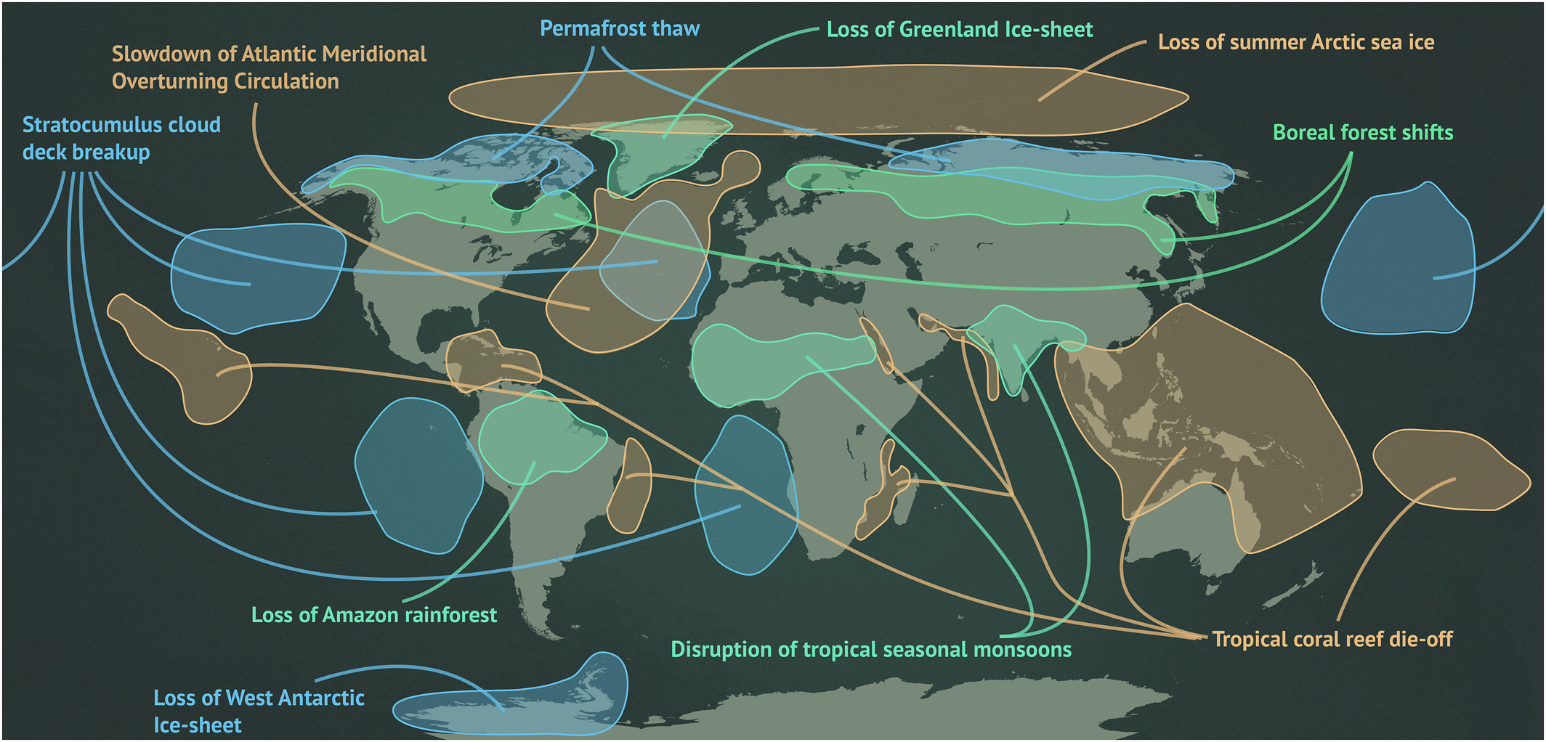

Slide 8
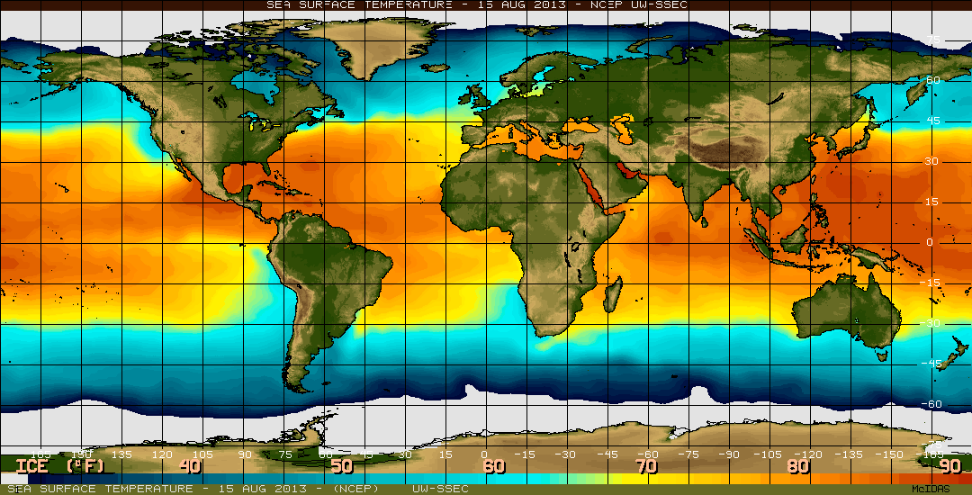
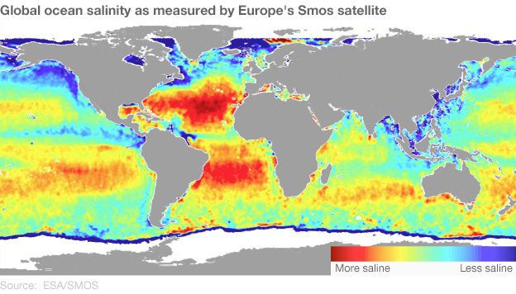
Atlantic Meridional Overturning Circulation (AMOC)
Currents also occur in the deep ocean (1-5 km below sea-level)
Motion is caused by density caused by temperature and salinity differences
Thermohaline Circulation

Slide 9
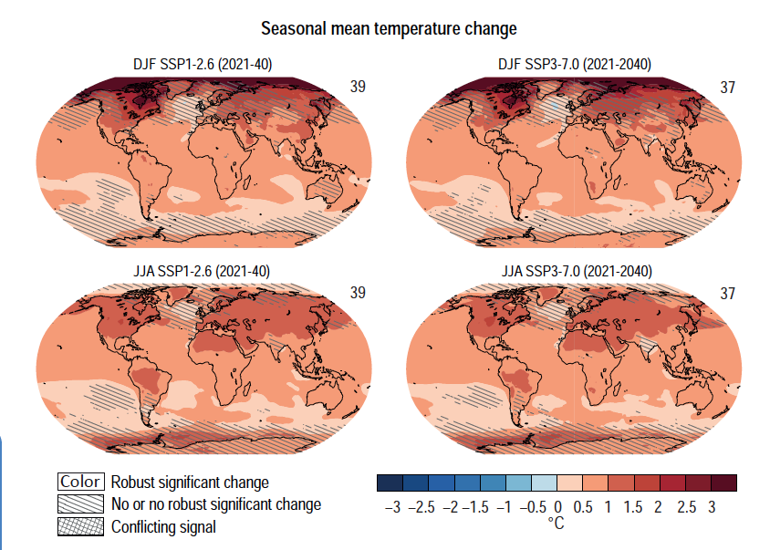
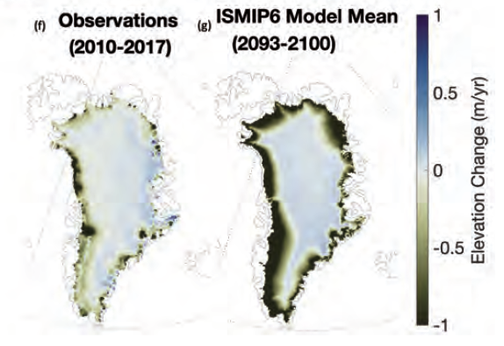
Climate change impacts
Sea water warming
Freshwater from ice sheet melt alters salinity

Slide 10
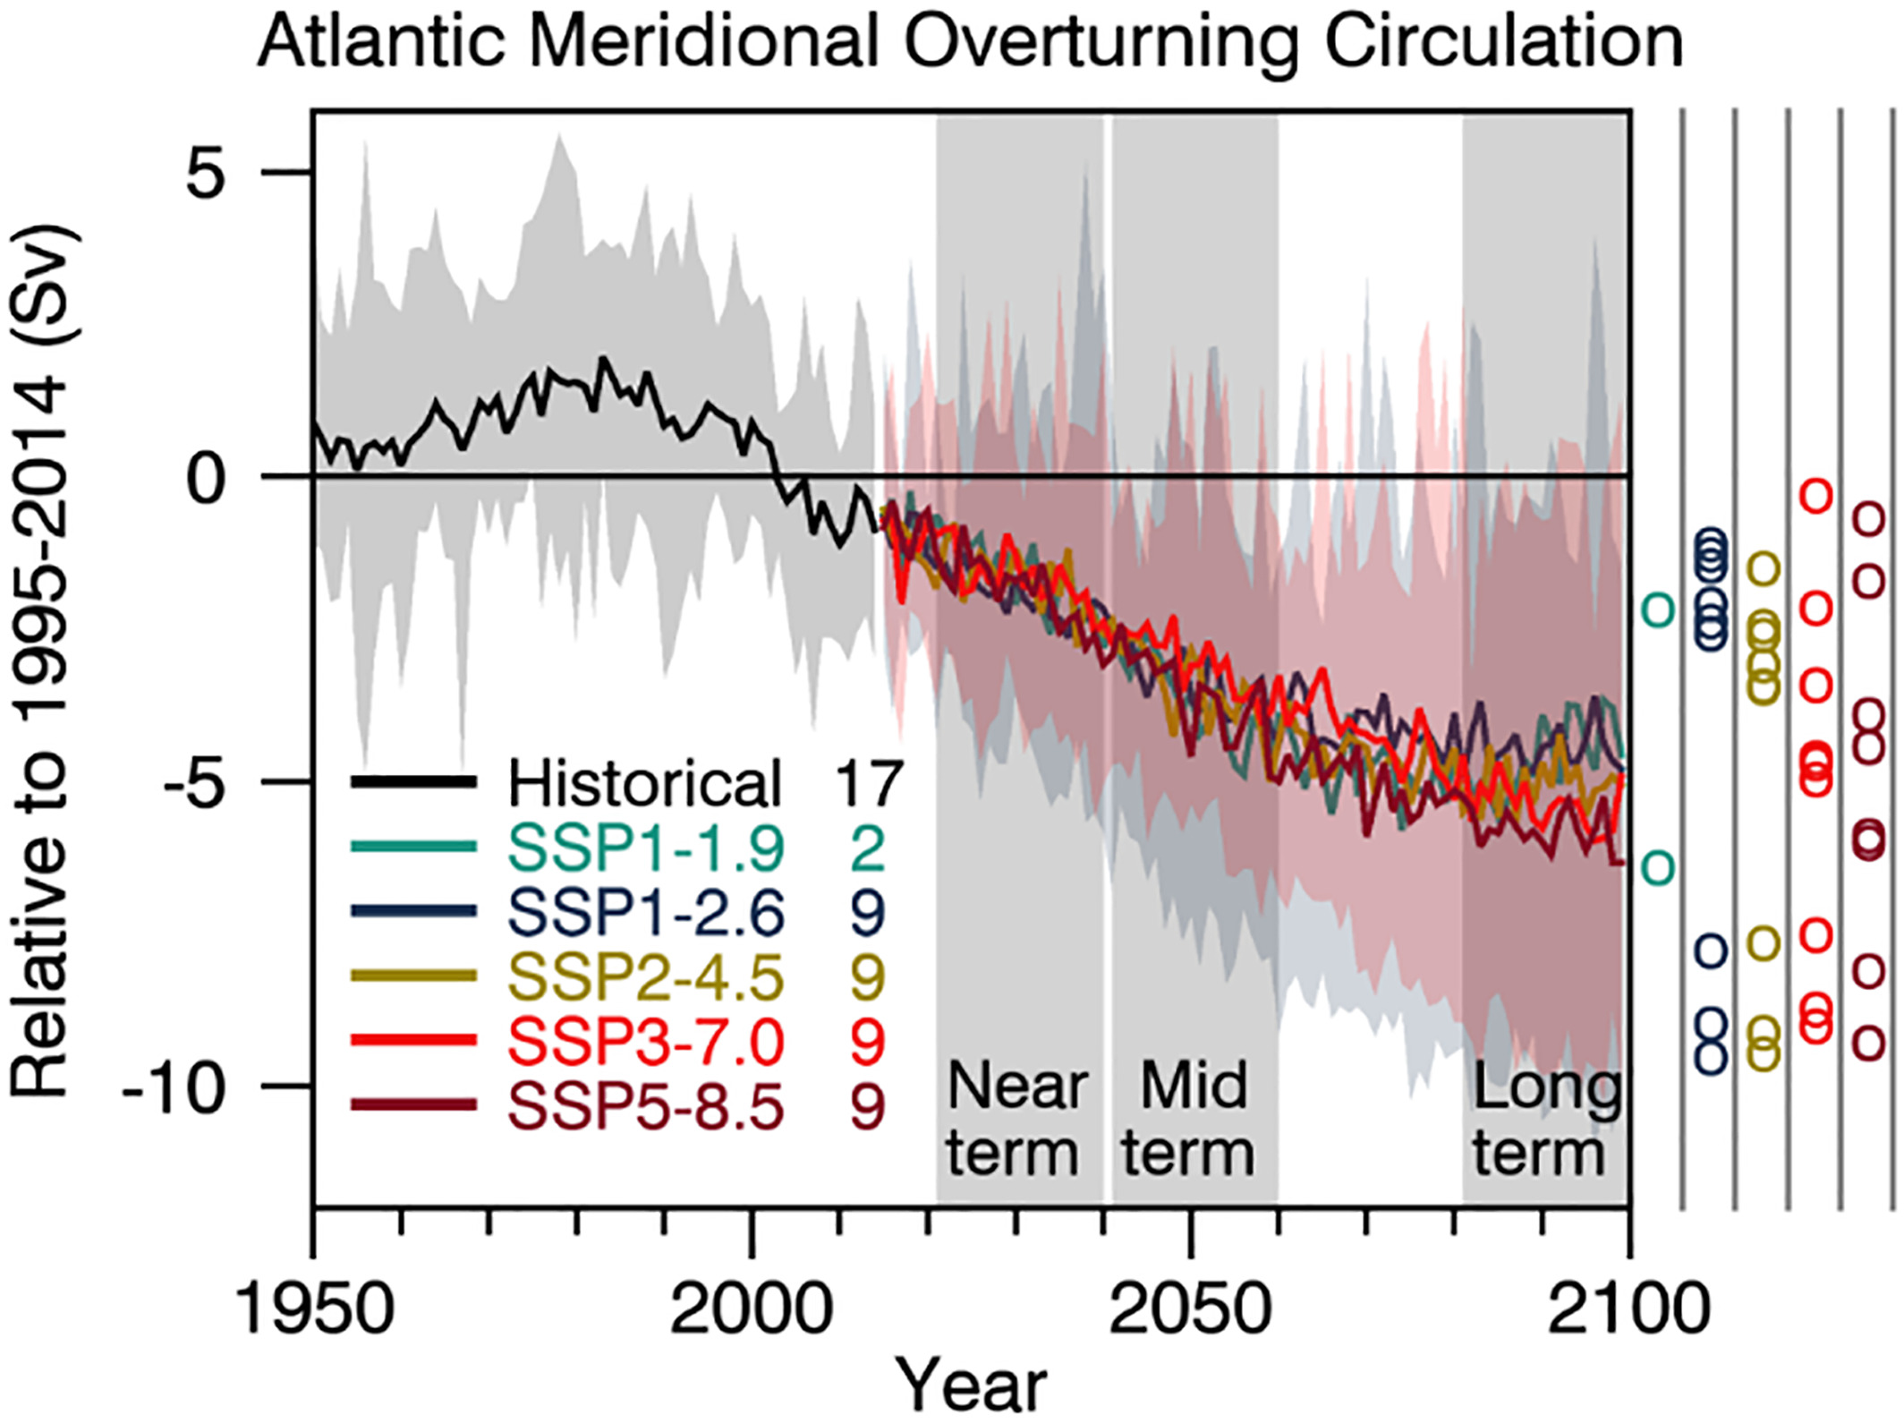
Climate induced changes in AMOC
Notes:
Figure 4.6 in the IPCC AR6 WG1 Ch 4

Slide 11
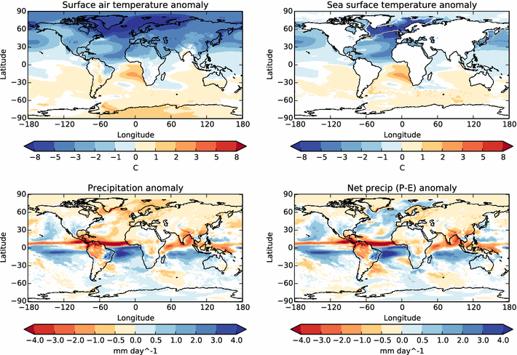
Impacts of a AMOC collapse
North Atlantic cooling
South Atlantic warming
Reduced North Atlantic rainfall
Southward shift of the tropical rain belt
Potentially irreversible
Notes:
https://link.springer.com/article/10.1007/s00382-015-2540-2

Slide 12
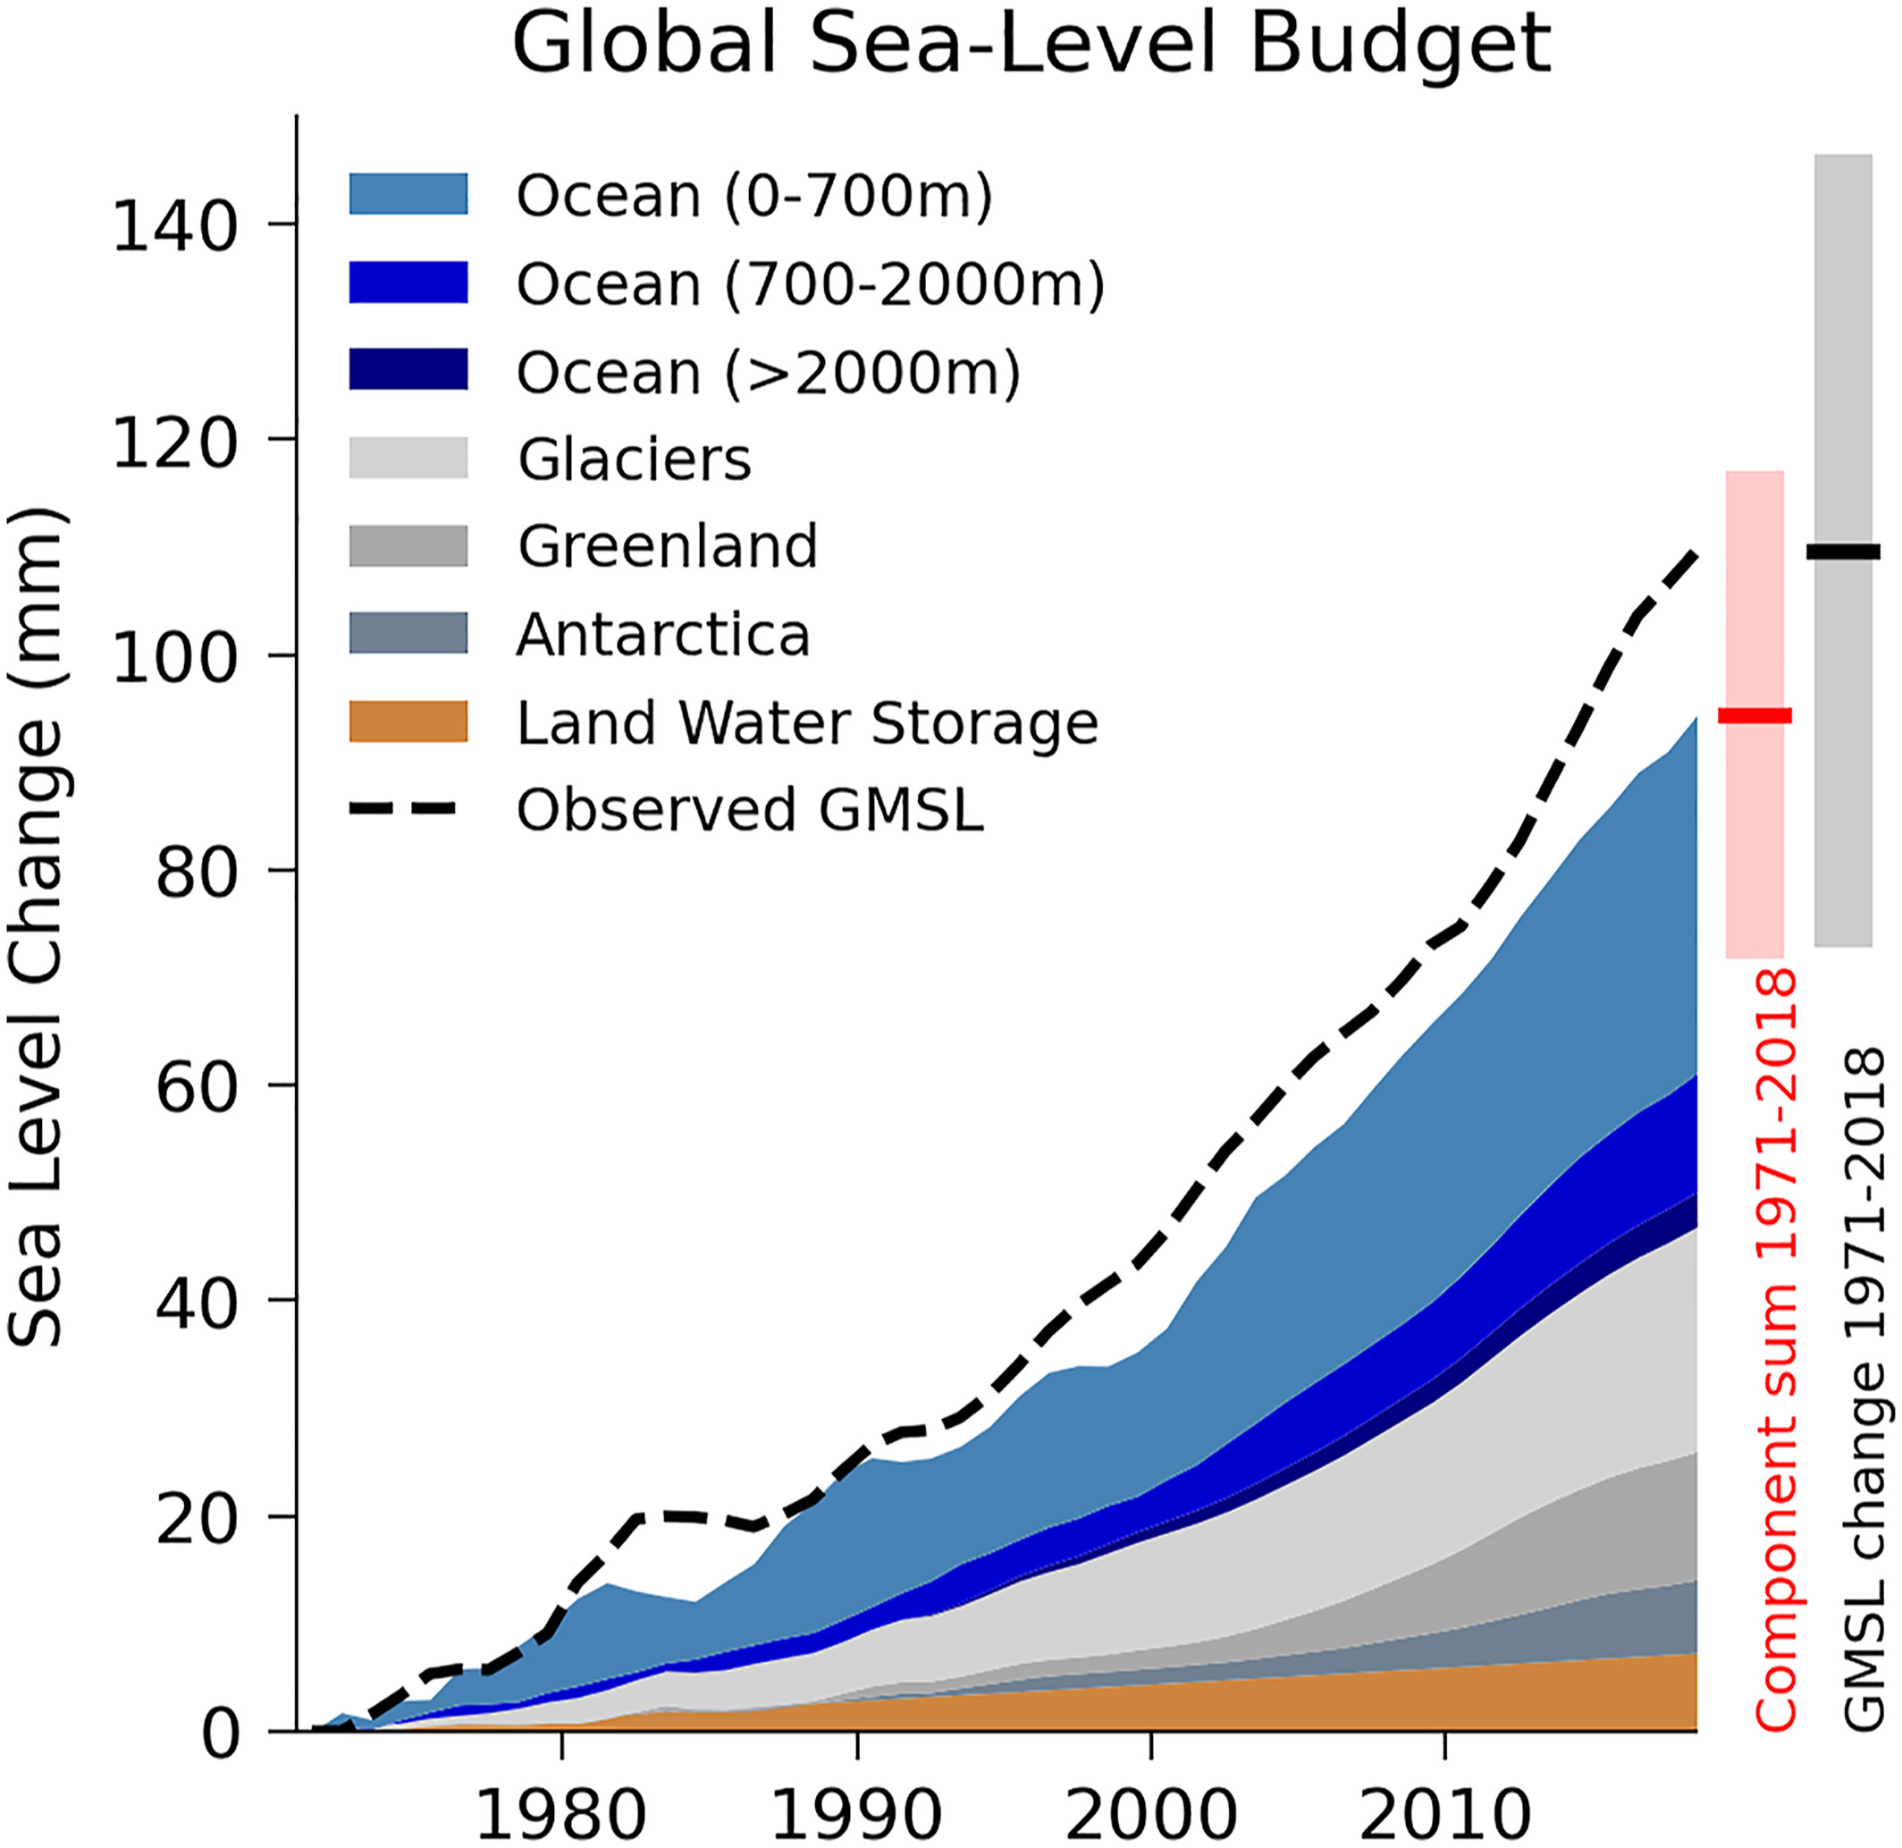
Loss of Greenland and Antarctic ice sheets
Notes:
Cross-Chapter 9.1, Figure 1 in the IPCC AR6 WG1 Chapter 9

Slide 13
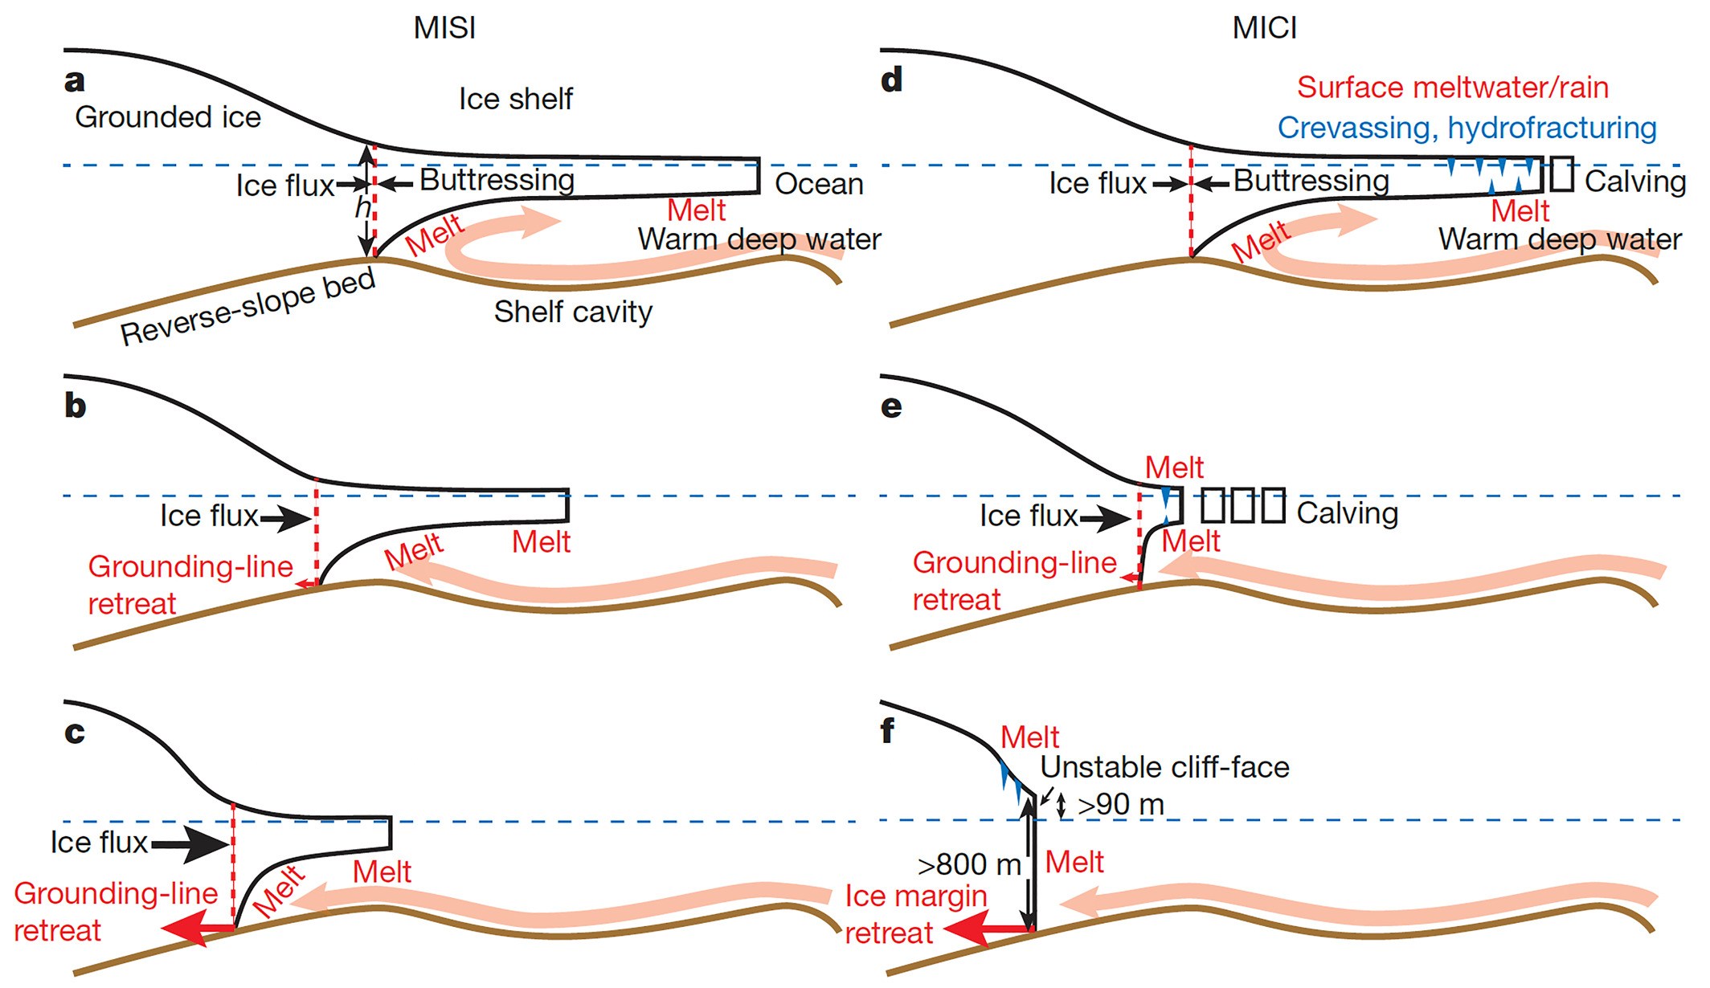
Collapse of Greenland and Antarctic ice sheets
Notes:
https://www.nature.com/articles/nature17145

Slide 14
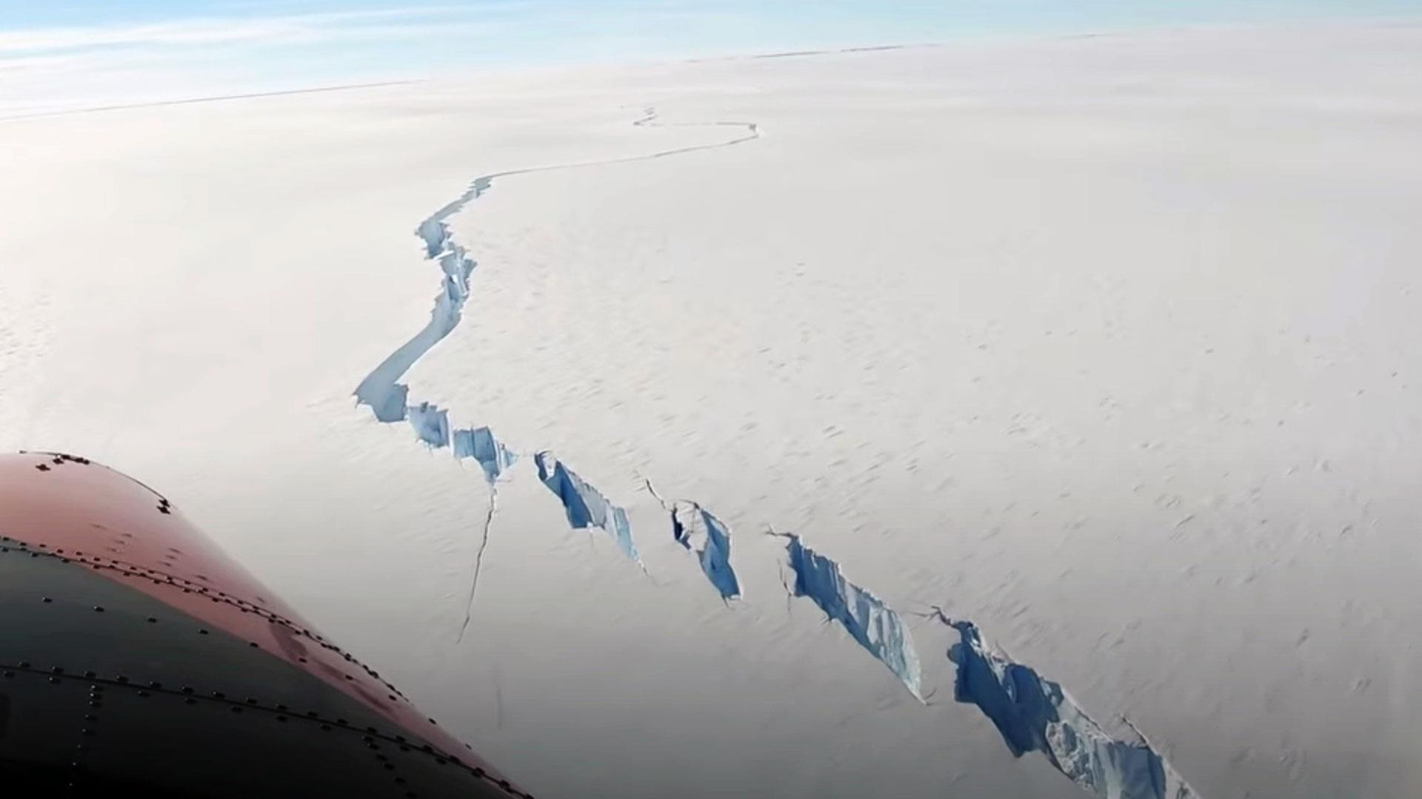
Impacts of ice sheet collapse
Sudden and significant sea level rise
Irreversible tipping point on a millennial scale – scale of ice sheet formation

Slide 15
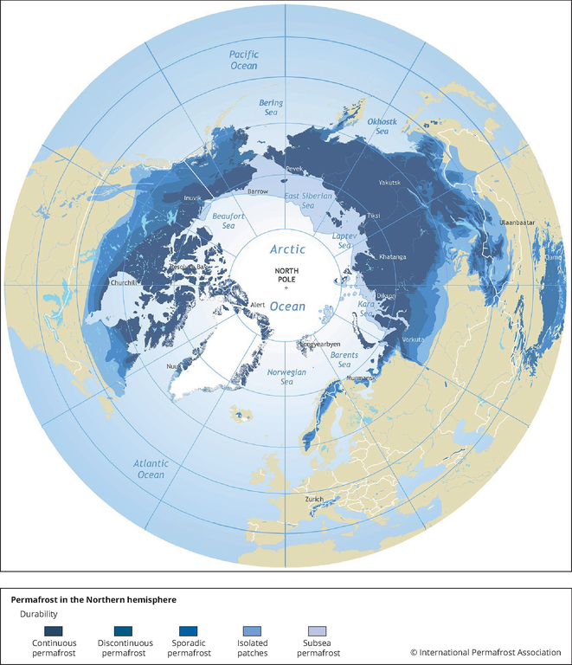
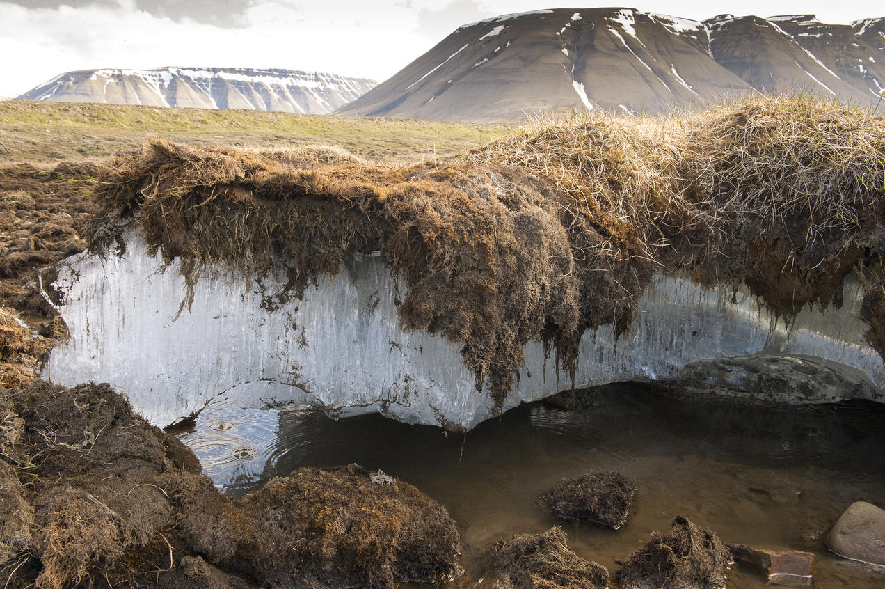
Thawing permafrost
Permafrost is soil that has been frozen for more than 2 years, most frequently hundreds of thousands of years
It contains large amounts of carbon through organic matter that does not decompose
Notes:
https://www.eea.europa.eu/data-and-maps/figures/permafrost-in-the-northern-hemisphere

Slide 16
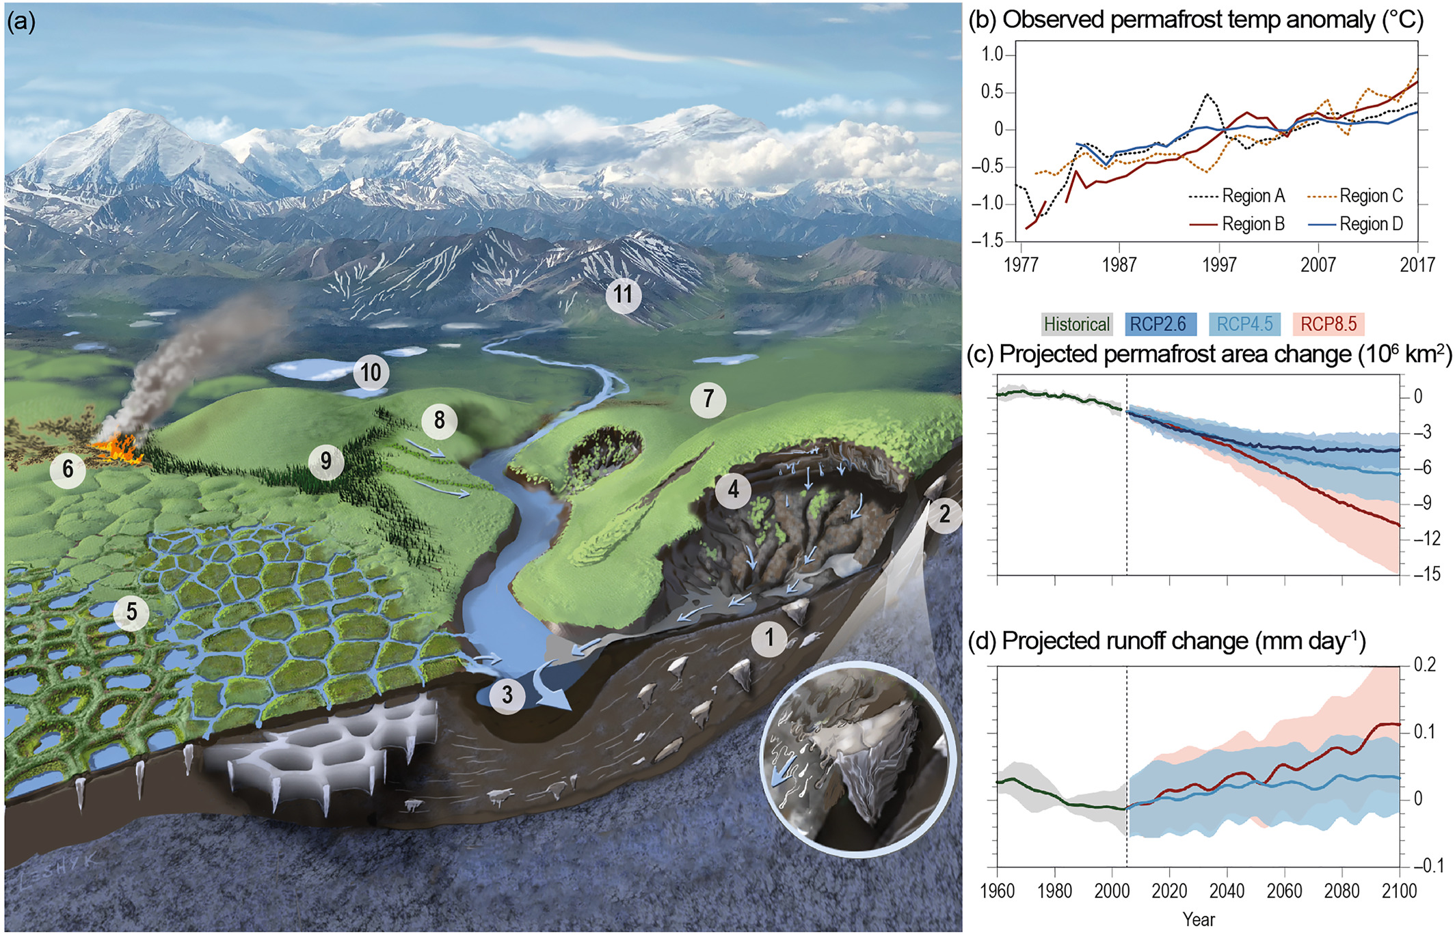
The Arctic is changing
permafrost
ground ice
river flow rates
abrupt thaw via landslides and small-scale processes
surface water accumulation,
wildfires
tundra biome shifts
shrub vegetation
boreal forests
lake ice
seasonal snow cover
Notes:
https://agupubs.onlinelibrary.wiley.com/doi/10.1029/2021RG000757

Slide 17
The Arctic is changing
Notes:
https://agupubs.onlinelibrary.wiley.com/doi/10.1029/2021RG000757

Slide 18
Higher than average temperature change in the Arctic

Slide 19
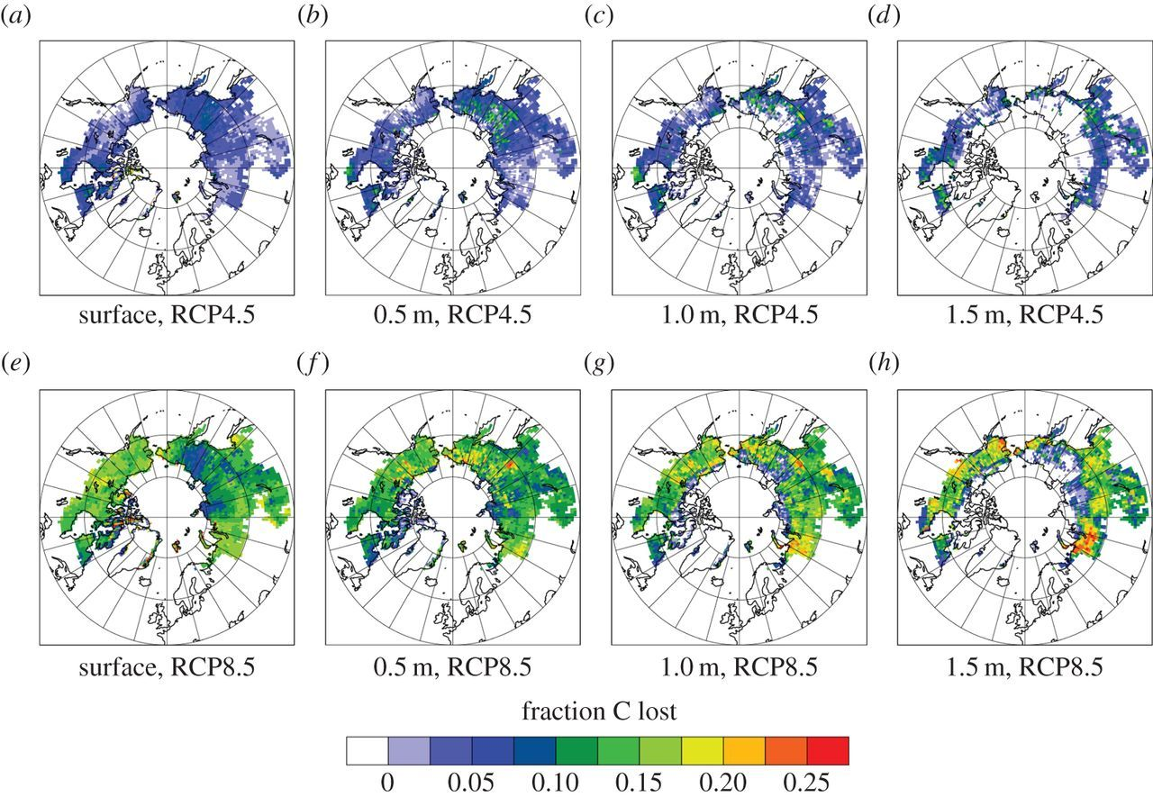
Carbon release from gradual thaw
Notes:
https://royalsocietypublishing.org/doi/10.1098/rsta.2014.0423

Slide 20
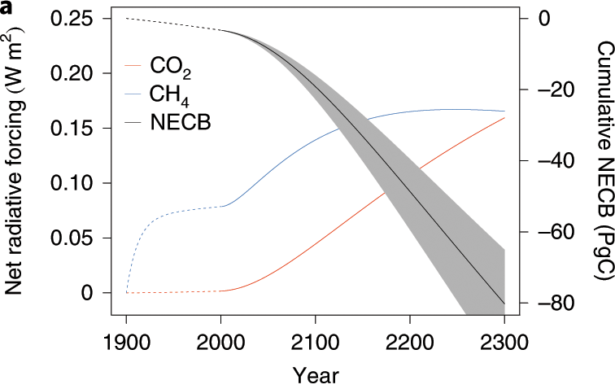
Carbon release from abrupt thaw

Slide 21
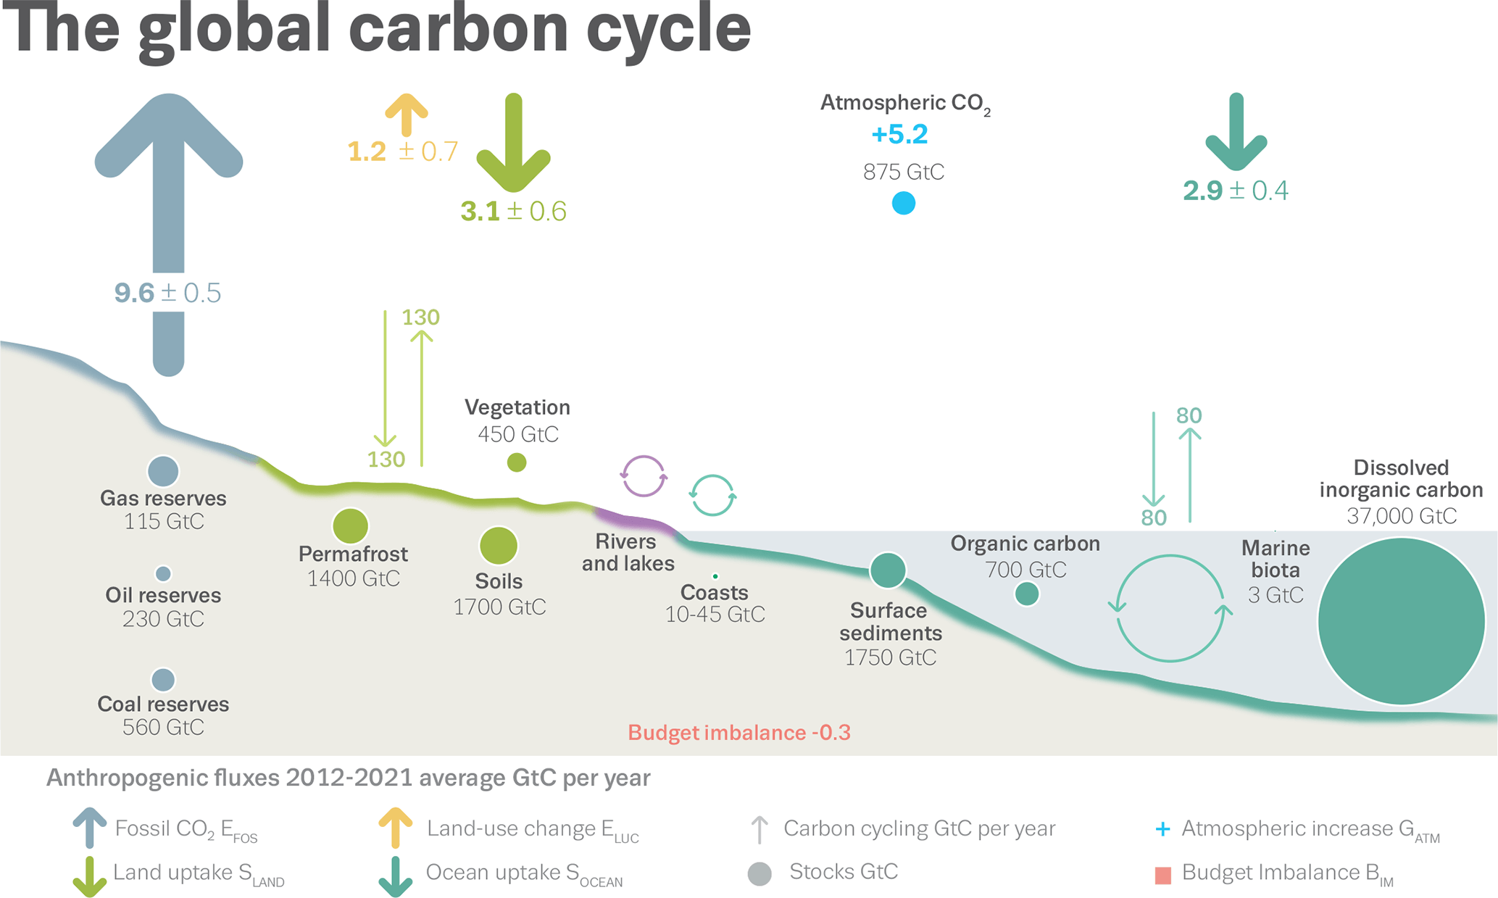
Impacts of permafrost thaw
Drastically increased CO₂ and CH₄ in the atmosphere
Irreversible on century timescales
New state of the climate system

Slide 22
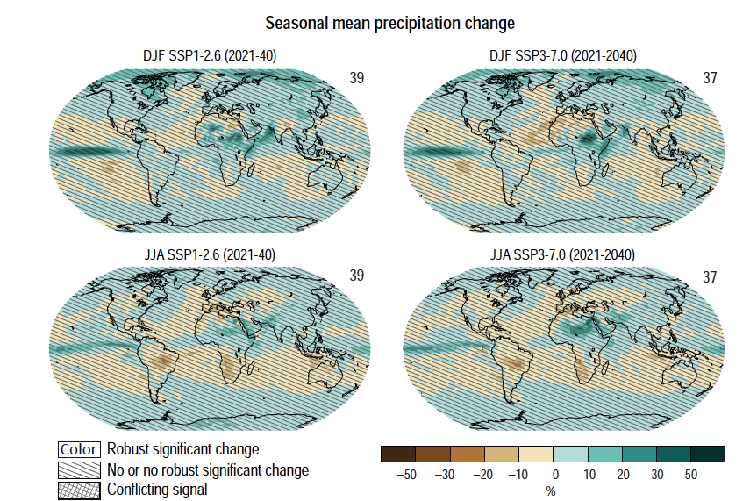
Boreal forest ecosystem shifts

Slide 23
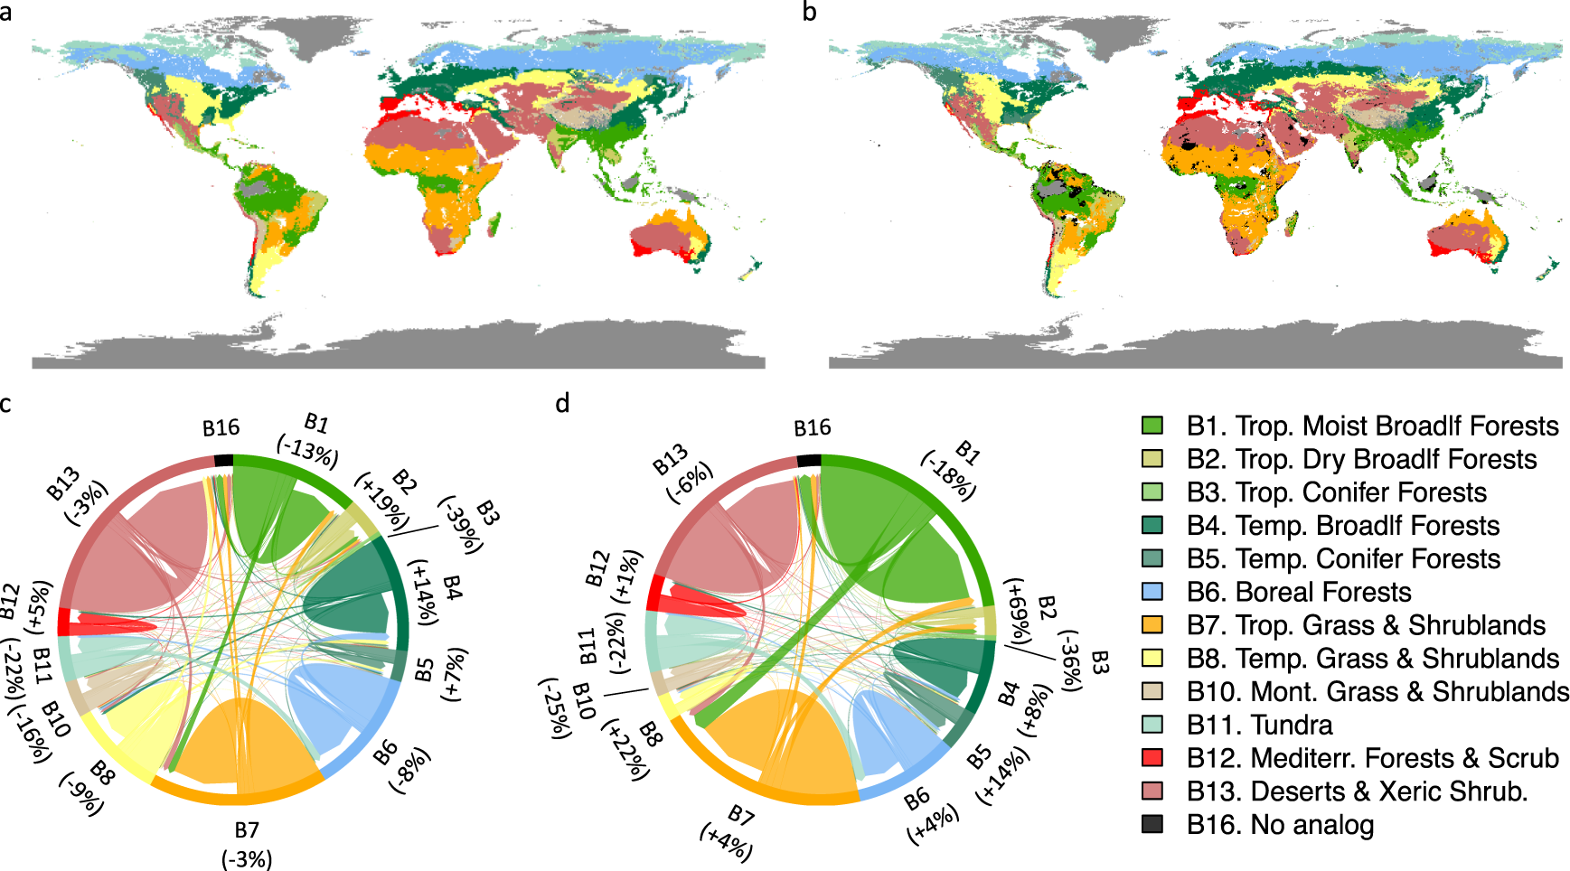
Boreal forest ecosystem shifts: nowhere to go
Notes:
https://www.nature.com/articles/s43247-021-00270-z

Slide 24
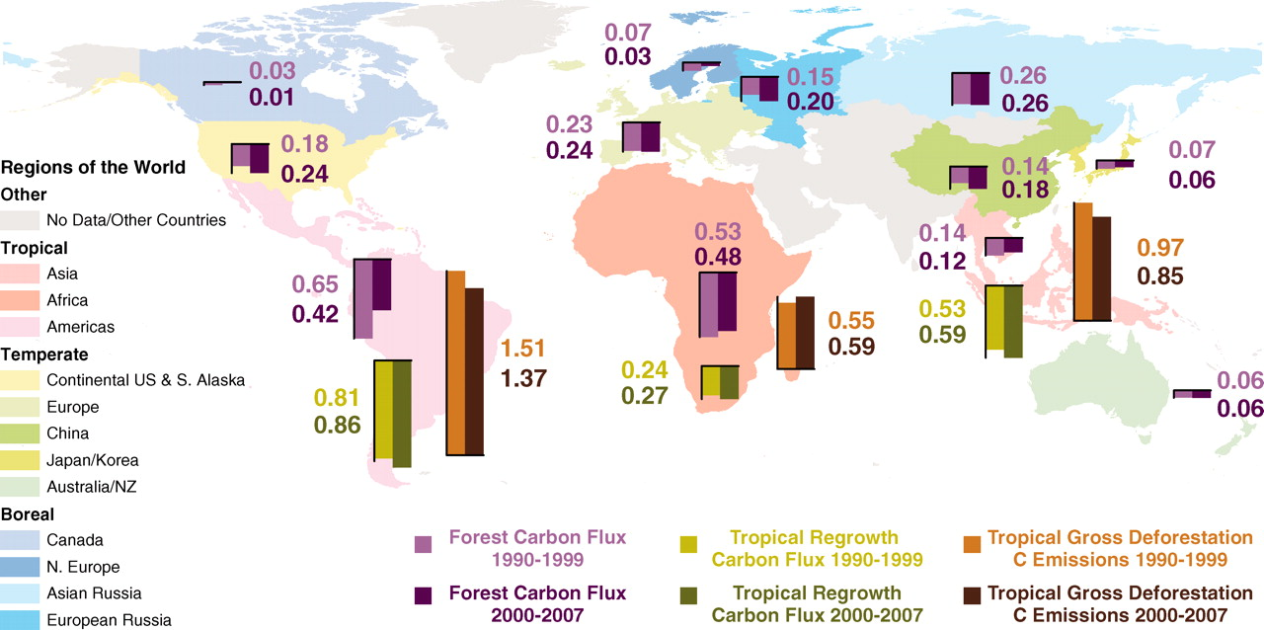
Amazon forest dieback
The Amazon forest is the single most important region in terms of C uptake and stocks
Notes:
https://www.science.org/doi/10.1126/science.1201609

Slide 25
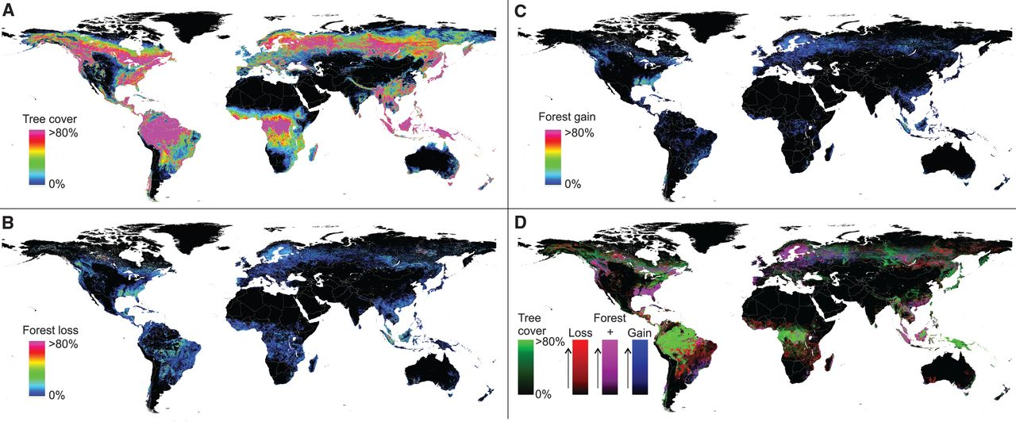
Deforestation in the Amazon region
Notes:
https://www.science.org/doi/10.1126/science.1244693

Slide 26
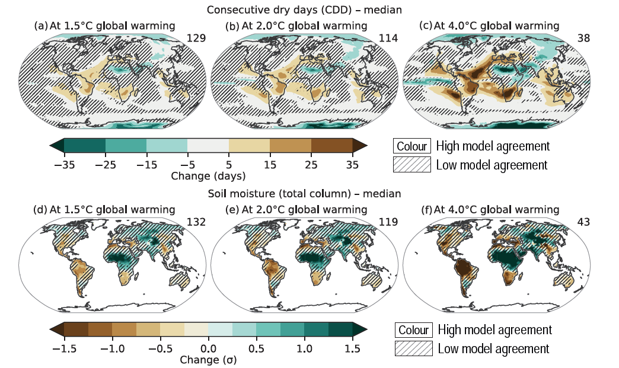
Severe droughts predicted for the Amazonian region
Notes:
IPCC WGI, chapter 11, figure 11.19

Slide 27
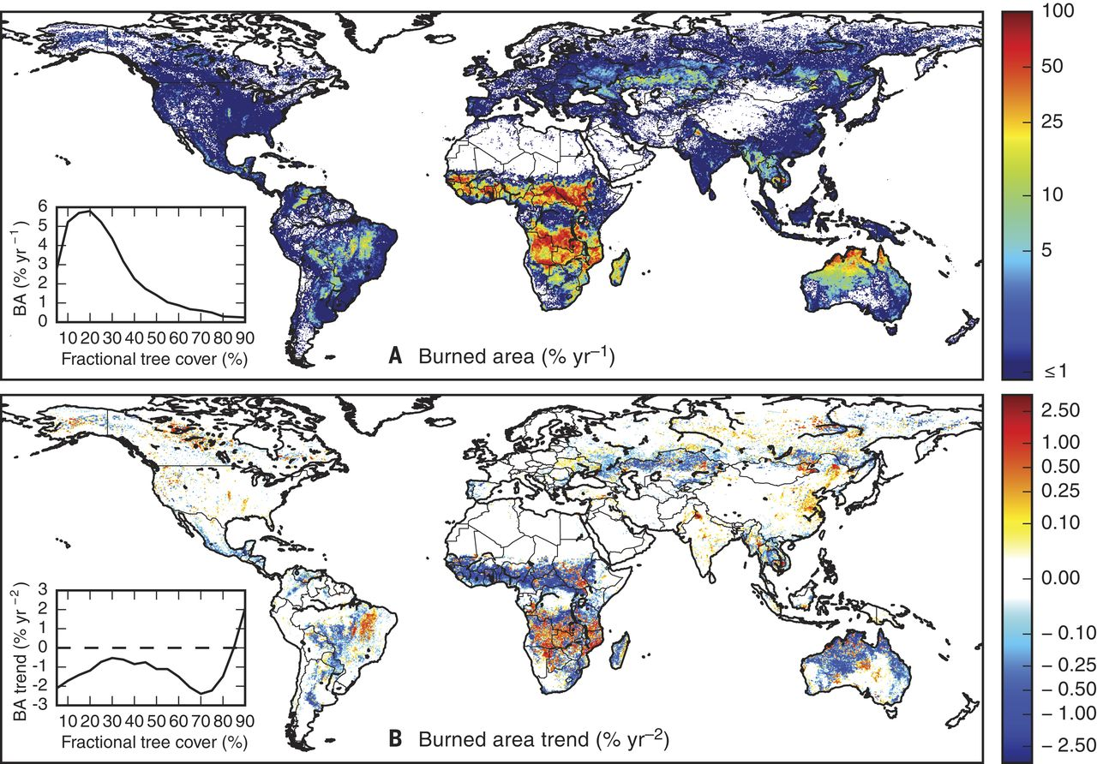
Increase in burned area in Southern Amazon
Notes:
https://www.science.org/doi/10.1126/science.aal4108

Slide 28
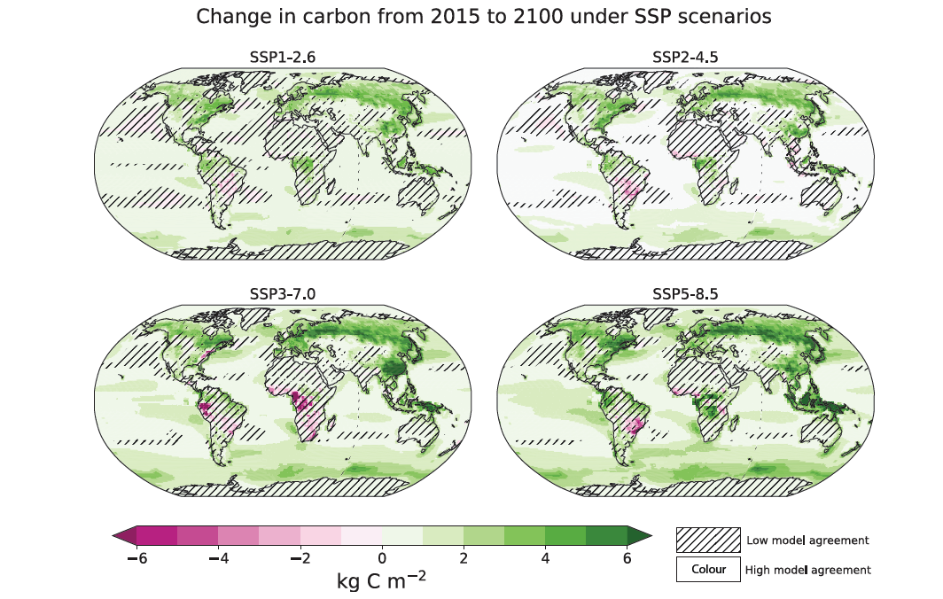
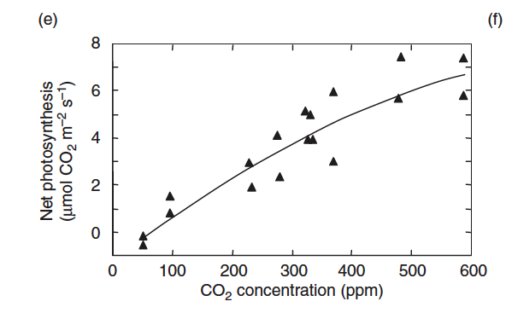
Climate feedbacks: carbon cycle
Disturbed ecosystems lose carbon already stored in biomass
Disturbed ecosystems can take up less C
Models predict an overall increase in the C sink but do not include any ecosystem dynamics and disturbance processes!
Notes:
IPCC WG I, chapter 5, figure 5.26

Slide 29
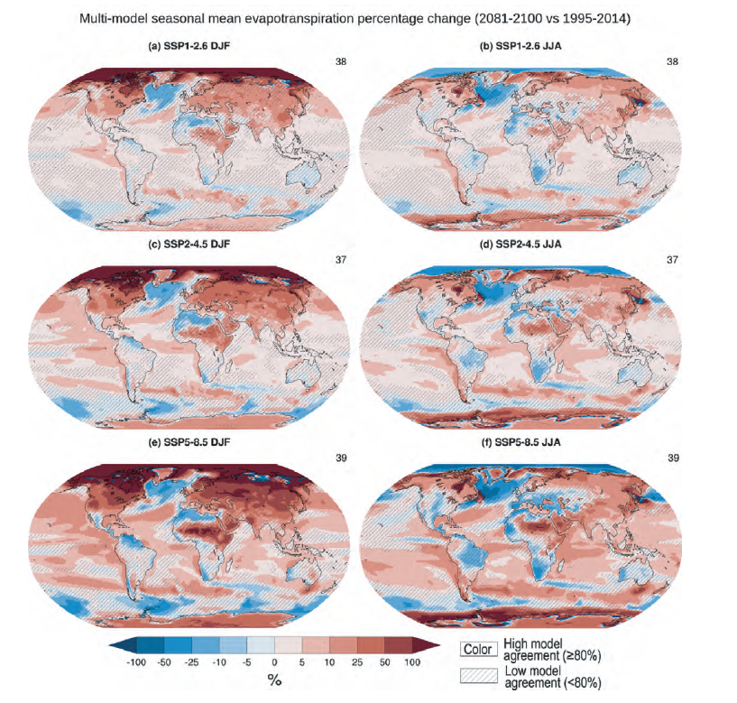
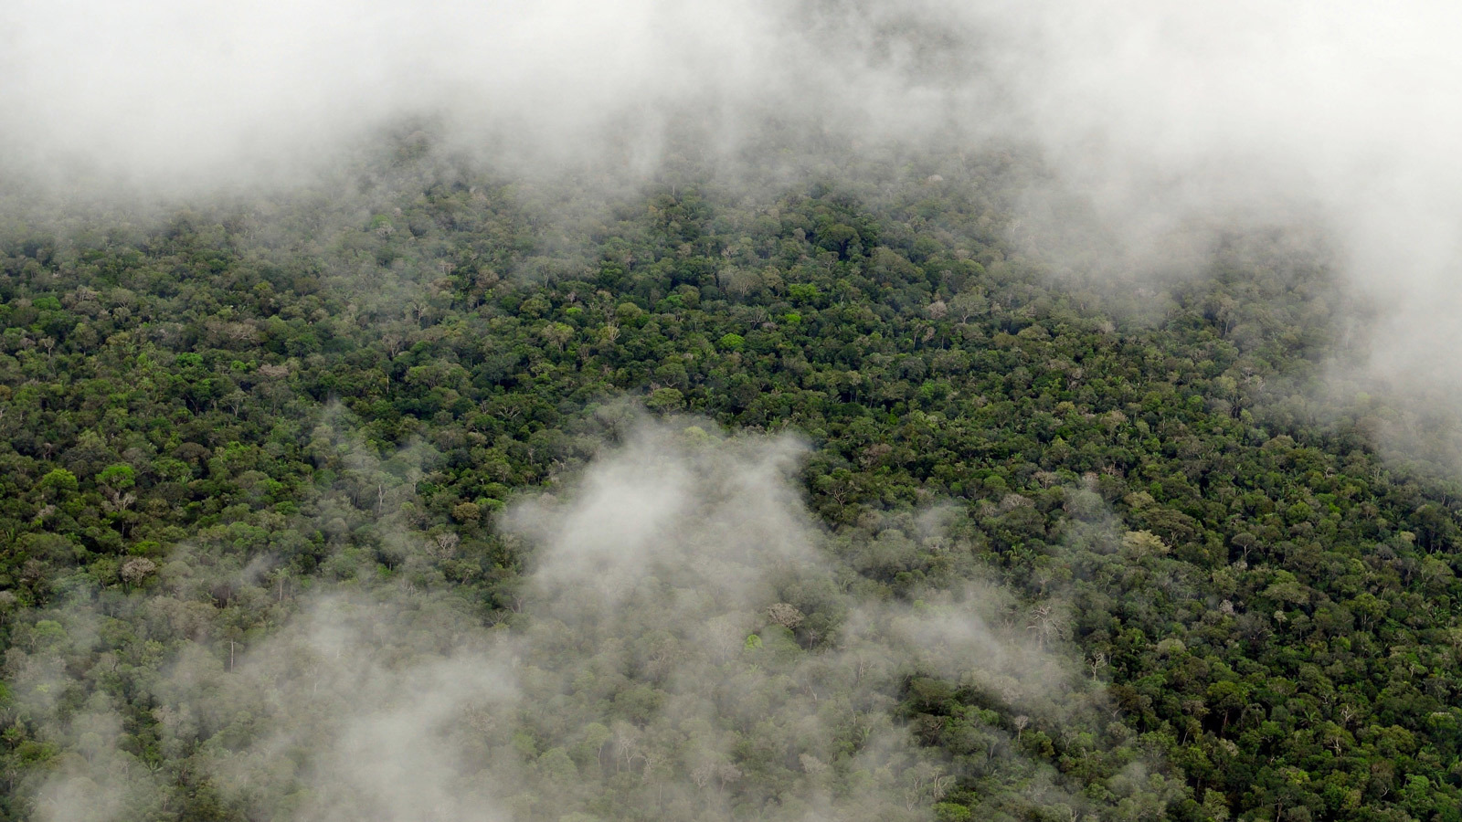
Climate feedbacks: evapotranspiration
Plants transfer water vapour to the atmosphere through transpiration
Losing forest area can decrease the amount of evaporation
Notes:
IPCC WG I, chapter 8, figure 8.17

Slide 30
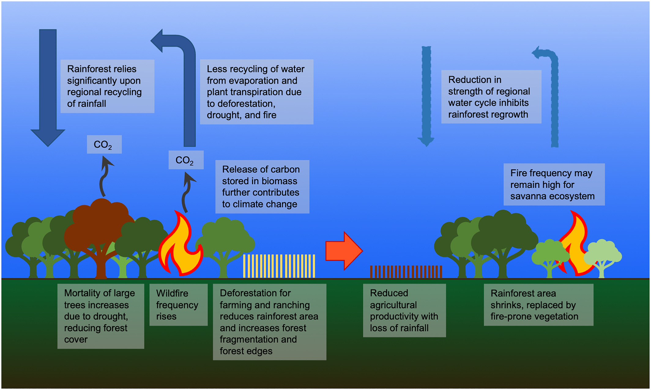
Notes:
https://agupubs.onlinelibrary.wiley.com/doi/10.1029/2021RG000757

Slide 31
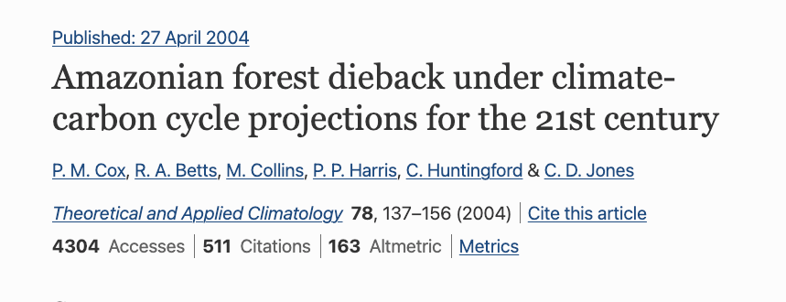
Scientists are sometimes wrong but can change their mind in the face of new evidence

Slide 32
Impacts of Amazon dieback
Release of CO₂ from soil C stocks
Reduced land C sink
Changes in regional water cycle
Irreversible on century timescales
New state of the climate system

Slide 33
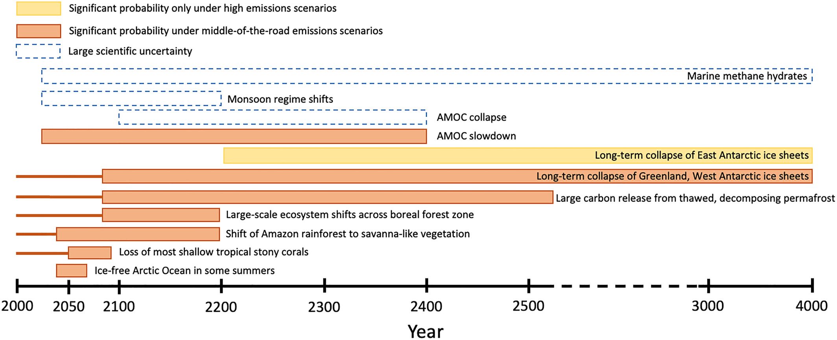
When could this happen?
Notes:
https://agupubs.onlinelibrary.wiley.com/doi/10.1029/2021RG000757

Slide 34
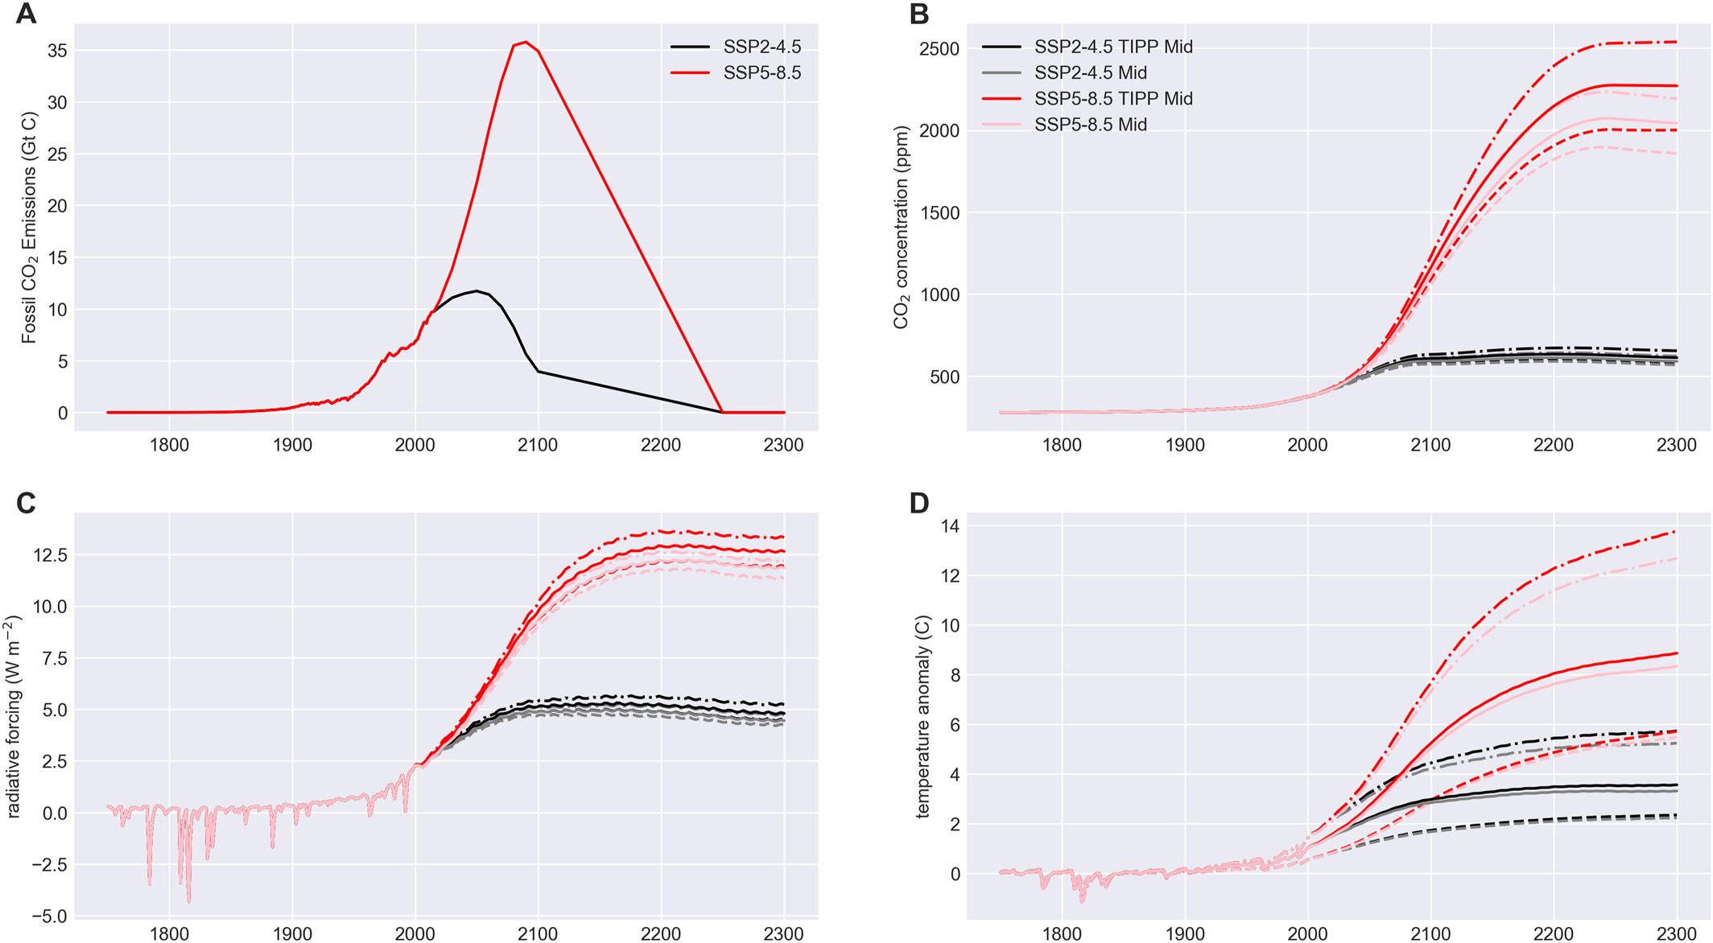
What are the effects?
Notes:
https://agupubs.onlinelibrary.wiley.com/doi/10.1029/2021RG000757

Slide 35
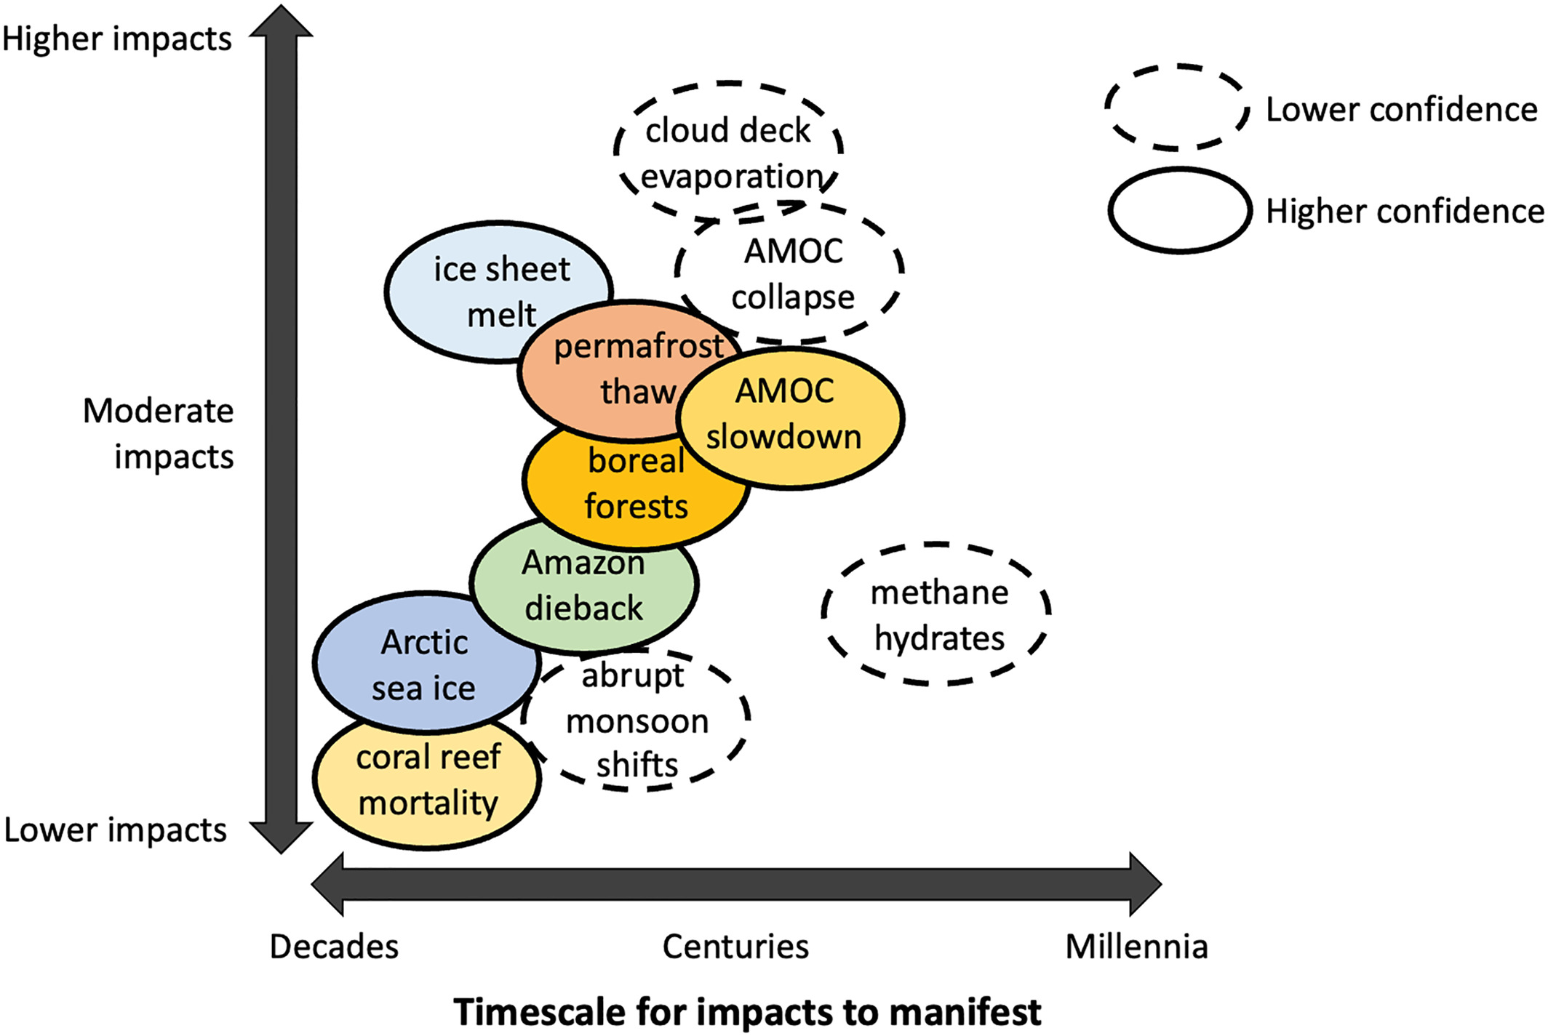
Impacts include added warming potential, sea-level rise, ecosystem shifts, and atmospheric and oceanic circulation changes
Notes:
https://agupubs.onlinelibrary.wiley.com/doi/10.1029/2021RG000757

Slide 36
Atmosphere
Climate fundamentals
Predicting climate
Atmosphere
Global C cycle
IPCC report
Earth system models
Climate impacts
Climate solutions
Extreme events
Tipping points
Sea ice, ice caps
Energy
Mitigation
Nature-based solutions

